Slide 1
Introduction to Chef Automation
Notes:
This Chef Essentials course provides a basic understanding of Chef's core components, basic architecture, commonly used tools, and basic troubleshooting methods.
This should provide you with enough knowledge to start using Chef to automate common infrastructure tasks and express solutions to common infrastructure problems.
Instructor Note: Be sure to read Appendix Z for training lab set up notes and additional instructor notes. IMPORTANT: This new version (2.0) of Essentials has a lot of new Day 2 content.
Instructor Note: If you have students with Windows workstations, for some Day 2 labs they will need git bash instead of Powershell. Those slides indicate that requirement so Windows users should install git bash before Day 2. IMPORTANT: This course was tested against ChefDK version 0.17.17. If you use a different version, the exercises and labs may not work properly.

Slide 2
Introduce Yourselves
Name
Current job role
Previous job roles/background
Experience with Chef and/or config management
Favorite Text Editor

Slide 3
Expectations
You will leave this class with a basic understanding of Chef's core components, architecture, commonly used tools, and basic troubleshooting methods
You bring with you your own domain expertise and problems. Chef is a framework for solving those problems. Our job is to teach you how to express solutions to your problems with Chef.
Notes:
Chef is not, in itself, a solution to your infrastructure problems. Chef is an automation framework. You bring the domain expertise about your own business and its problems. Chef provides a platform for modeling solutions to those problems. Our job in this class is to work together to teach you how to express solutions to your unique problems with Chef.
Together we get unicorns and rainbows, but we can't have one without the other.

Slide 4
Course Objectives
After completing this course, you should be able to:
Use Chef Resources to define the state of your system
Use the Chef Development Kit to build and test cookbooks
Understand the concepts of building reusable cookbooks across your organization

Slide 5
Agenda
Getting a Workstation
Resources and recipes
Writing a web server cookbook
Testing with Test Kitchen
Details About a System
Desired State and Data

Slide 6
Chef
Chef can automate how you build, deploy, and manage your infrastructure.
Chef can integrate with cloud-based platforms such as Azure and Amazon Elastic Compute Cloud to automatically provision and configure new machines.
Notes:
Chef can automate how you build, deploy, and manage your infrastructure. Your infrastructure becomes as versionable, testable, and repeatable as application code enabling you to automate the process of configuring, deploying and scaling servers and applications

Slide 7
Chef
Chef is a large set of tools that are able to be used on multiple platforms and in numerous configurations.
Learning Chef is like learning a language. You will learn the basic concepts very fast but it will take practice until you become comfortable.
A great way to learn Chef is to use Chef
Notes:
Chef is a large set of tools that are able to be used on multiple platforms and in numerous configurations. We will have time to only explore some of its most fundamental pieces.
Learning Chef is like learning a language. You will lean the basic concepts very fast but it will take practice until you become comfortable.

Slide 8
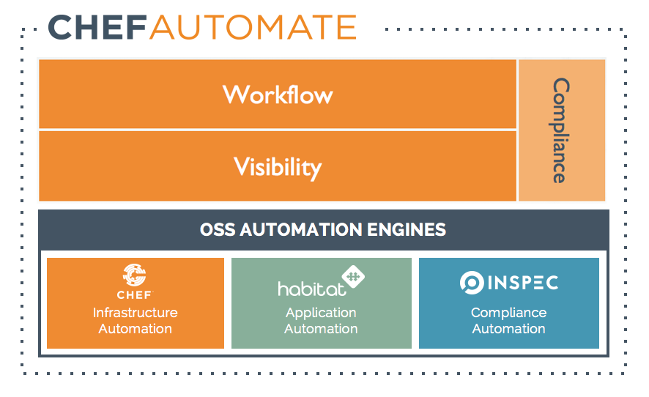




High Level Chef Architecture
OSS AUTOMATION ENGINES
Infrastructure Automation
Application
Automation
Compliance
Automation

Slide 9
Chef is...
An automation framework that enables Infrastructure as Code
A robust set of tooling for testing Chef code
A large library of reusable patterns (supermarket.chef.io)
Available for Linux variants, Unix variants, and Windows, all as first class citizens.
CHEF IS INFRASTRUCTURE AS CODE
Programmatically provision and configure components
Treat like any other code base
Reconstruct business from code repository, data backup, and compute resources

Slide 10
The Chef DSL (domain specific language)
Programmatically provision and configure components
Declarative DSL with the flexibility
Built on Ruby
Extensible through Ruby

Slide 11
Treated Like Any Other Codebase…
Stored in source control
Testing Coverage
Part of your CI or CD pipelines

Slide 12
Core Chef Concepts
Cookbooks
Recipes
Resources

Slide 13
Building Blocks: What is a Resource?
A Resource is a system state you define
Example: Package installed, state of a service, configuration file existing
You declare what the state of the resource is
Chef automatically determine HOW that state is achieved
windows_feature 'IIS-WebServerRole' do
action :install
end
package 'httpd' do
action :install
end

Slide 14
Building Blocks: What is a Recipe?
A recipe is a collection of Resources
Resources are executed in the order they are listed
On Linux based OSes:
package 'httpd' do
action :install
end
template '/var/www/index.html' do
source 'index.html.erb'
mode '0644'
end
service 'httpd' do
action [ :enable, :start ]
end
windows_feature 'IIS-WebServerRole' do
action :install
end
template 'c:\inetpub\wwwroot\Default.htm' do
source 'Default.htm.erb'
rights :read, 'Everyone'
end
service 'w3svc' do
action [ :enable, :start ]
end

Slide 15
Building Blocks: What is a Cookbook?
A cookbook is a set of recipes
A cookbook is a defined set of items and different outcomes that you expect to address
A cookbook could have a recipe to install apache2/httpd but also another set of recipes to activate modules required.
./attributes
./attributes/default.rb
./CHANGELOG.md
./metadata.rb
./README.md
./recipes
./recipes/application.rb
./recipes/balancer.rb
./recipes/database.rb
./recipes/default.rb
./recipes/webserver.rb
./templates
./templates/default
./templates/default/mysite.conf.erb

Slide 16
Chef Fundamentals
Ask Me Anything: It is important that we answer your questions and set you on the path to find more.
Break It: If everything works the first time go back and make some changes. Break it!
Notes:
Ask Me Anything: All of us are coming here with unique experiences and from unique teams that are using Chef in unique ways. It is important that we answer your questions and set you on the path to find more.
Break It: If everything works the first time go back and make some changes. Break it! It's rare that you have a safe space like this to explore. Sometimes its more important to know what something looks like when it does not work than when it does work.

Slide 17

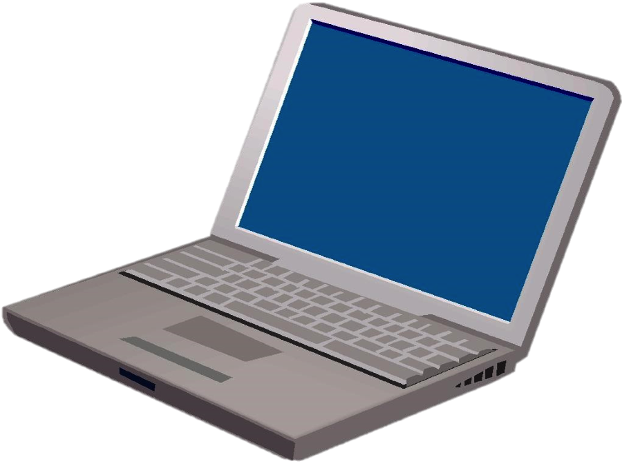
Chef Lab System Architecture
Lab Architecture
Virtual Workstation
Preconfigured with Chef tools
Your Laptop
Notes:
This is the architecture you'll start using in a few minutes. To ensure the smoothest setup experience, you'll be using a virtual workstation with all the necessary tools installed so you can start using Chef right away.

Slide 18
Hands-on Legend
GL or Group Lab: All participants and the instructor do this task together with the instructor often leading the way and explaining things as we proceed.
Lab: You perform this task on your own.
Notes:
In this course, various slides and pages will be tagged with either Group Lab (or GL), or Lab. This slide defines those tags.

Slide 19
Group Lab: Pre-built Workstation
We will provide for you a workstation with all the tools installed.
Login to the Remote Workstation
Notes:
As I mentioned there is a lot work planned for the day. To ensure we focus on the concepts we introduce and not on troubleshooting systems we are providing you a workstation with the necessary tools installed to get started right away.
Instructor Note: At the end of the training it is often a good idea to offer your services to help individuals install necessary software or troubleshoot their systems.

Slide 20
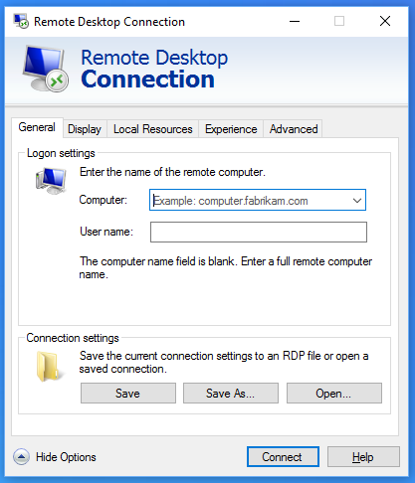
GL: Login to the Remote Workstation
Use the address, user name, and password to connect to the remote workstation.
USER: \Chef
PASSWORD: RL9@T40BTmXh

Slide 21
Group Lab: Pre-built Workstation
We will provide for you a workstation with all the tools installed.
Login to the Remote Workstation
Notes:
Now that you are connected to that workstation we have taken care of all the necessary work to get started with the training.

Slide 22
Getting a Workstation
The chef user has been granted password-less sudoers access
The following software is installed on the remote workstation:
Chef DK
Atom, Visual Studio Code
kitchen-ec2 gem
Inspec gem

Slide 23
Handy Links
The following page will give you handy links and save you typing
https://github.com/anthonygrees/compliance-workshop

